Slide 1
Measuring the Federal (Public) Funding of
Research & Development Projects Using Administrative Data
SDAD DSPG Team: Alyssa Fowers, Sean Pietrowicz, Joel Thurston, Stephanie Shipp
Sponsor: John Jankowski. R&D Statistics Program, National Center for Science & Engineering Statistics. National Science Foundation
July 9, 2019

Slide 2
Project Summary and Goals
Enhancing or supplementing research and development data
NSF National Center for Science & Engineering Statistics (NCSES) survey (census) data with publicly available administrative data
Providing International Standards for Science, Technology, Innovation (STI) Data
Organisation for Economic Co-operation and Development (OECD) - National Experts on Science and Technology Indicators (NESTI): – our NSF sponsor chairs this working group
Why this matters
Tracking funding to the project level will allow detailed analysis of R&D funding (fields of study, amount of funding, other)
Goals
Document availability and quality of administrative data to measure public R&D expenditures across federal agencies using a common template.
Assess feasibility of building a micro database of public funding for R&D projects based on administrative data
Notes:
Focus on enhancing or supplementing the NSF National Center for Science & Engineering Statistics (NCSES) survey data with publicly available administrative data to better measure public research and development (R&D) projects.
Also of interest to OECD-NESTI: Providing International Standards for Science, Technology, Innovation (STI) Data – our sponsor chairs this working group
Why this matters:
Although federal funding information of public R&D is documented until the agency level, tracking funding to the project level will allow analysis of projects (fields of study, amount of funding, other)
Goals:
Provide documentation about public R&D expenditures across federal agencies using a common template.
Assess feasibility of building a micro database of public funding for R&D projects based on open and available administrative data
Federal R&D data is reported based on high-level, aggregated survey results, so it’s challenging to investigate specific research topics over time, e.g. how much funding is allocated to nanotechnology projects?
This project will allow the NCSES to learn about the feasibility of accessing and analyzing non-survey data about public R&D.
By consolidating screening and organizing R&D funding information into a common template, NCSES can analyze the extent of investment into specific scientific fields.

Slide 3
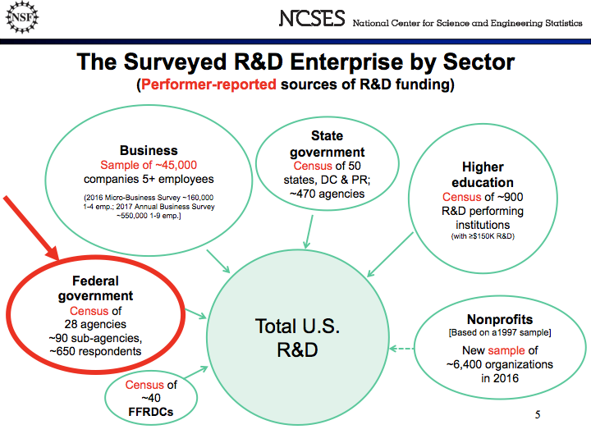
Notes:
The NSF collects data from all sectors about their sources of R&D funding. They collect this data using surveys and censuses. We are interested in assessing the feasibility of measuring federal public funding of R&D to universities and nonprofit organizations using administrative data in place of a survey of federal agencies. (In this case, it is actually a census because all agencies are included.)

Slide 4
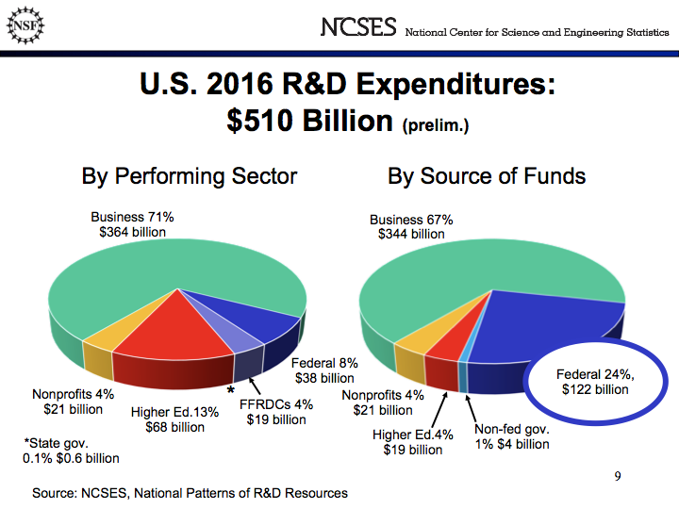
Notes:
We are focusing on measuring the Federal Sources of R&D funding which represents about almost 25% of all sources of R&D fundind or $122 billion.

Slide 5
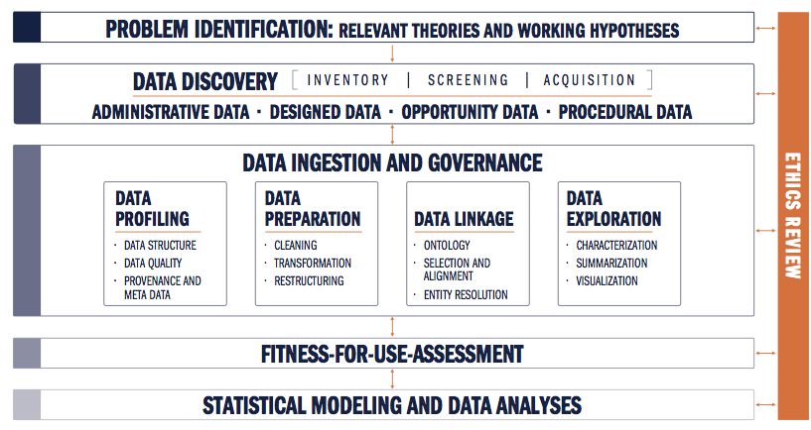
Ethical Review of Research
The data for this project are entirely available to the public and contains no confidential or classified information.
Because our goal is to document and organize already existing public information, there appears to be no potential for ethical conflicts in this project.

Slide 6














Data Discovery

Slide 7


NASA
Science Research Directorate | Aeronautics Research Mission Directorate | Human Explorations and Operations Mission Directive
Data Discovery: Departments and Agencies
Department of Energy
Office of Science
ARPA-E
Nuclear Energy
EERE
Office of Electricity
NIFA
ARS
Natural Resources
ERS
Department of Defense
DARPA
ONR
ARI
ARO
AFRL
AFOSR
CDMRP
Science Research
Aeronautics Research
Human Explorations
NCI
NEI
NHLBI
NHGRI
NIA
NIAAA
NIAID
NIAMS
NIDCD
NIDDK
NIDA
NIEHS
NIGMS
NIMH
NIMHD
NINDS
NINR
CIT
FIC
NCATS
NCCIH
NIBIB
NICHD
NLM
CC
CSR
NIDCR
BIO
CISE
EHR
ENG
ERE
GEO
OIA
OISE
MPS
SBE

Slide 8
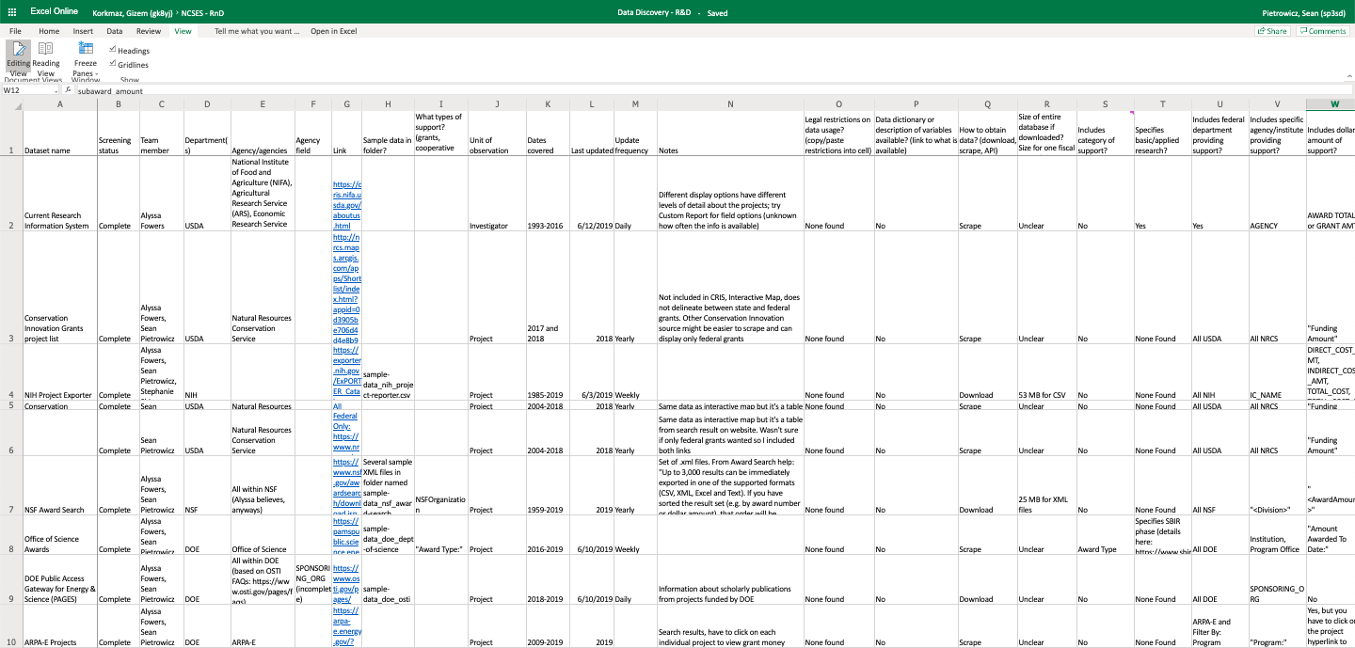
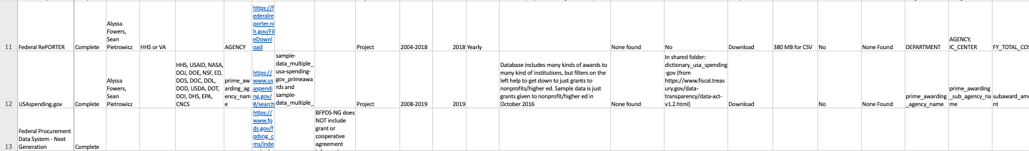
Data Discovery: Screening

Slide 9
Data Discovery: Screening
Asked 27 screening questions of 11 publicly available databases.
Good date coverage, some direct downloads available, detailed information about areas of inquiry and research institutions.
Ease of obtaining/ interpreting data
Matching to survey data
Enabling detailed analysis
Basic information
Data dictionaries
Grants vs cooperative agreements
Basic vs applied research
Start more detailed profiling with Federal RePORTER and USAspending.gov
Linked to publications
Institution type
R&D vs general S&E

Slide 10
Data Discovery: Coverage
Each agency has some amount of coverage in our data sources, but we are still evaluating the completeness of that coverage.
Energy
Defense
Source
Fed RePORTER
USA Spending
Current Research Information System
Conservation Innovation Grants project list
NIH Project Exporter
Conservation Innovation Grants All Project List
NSF Award Search
Office of Science Awards
DOE Public Access Gateway for Energy & Science (PAGES)
ARPA-E Projects
Total Potential Data Sources | 4 | 2 | 2 | 3 | 3 | 5

Slide 11
Data Profiling
Assessing data quality:
Completeness: % of values that are not blank or NA
Value validity: % of values in the right format for information (e.g. dates in a date field, only actual state names in state fields, etc.)
What percentage of projects and funding is accounted for?
%, count, and total dollar amount of grants in each department, sub-agency and office - compare against the NSF Survey of Federal Science … Support (FSS)

Slide 12
Completeness
How much data are missing?
Created an automated process that returns percentages of complete (not N/A or blank) values for each field in the dataset
Especially relevant for tracking funding amounts and organization name
Frequency of Congressional District Entries
CONGRESSIONAL_DISTRICT | freq
07 | 12010
02 | 8733
01 | 7612
05 | 7228
N/A | 6560
03 | 6294
12 | 6125
04 | 4090
13 | 3874
09 | 3019

Slide 13
Validity
How much data are relevant and correctly formatted?
Specialized process for each field that tracks amount of incorrectly formatted and misplaced data.
Process returns the percentage of projects and funding inputted correctly
Prepared R scripts to:
Ensure proper formatting for
state abbreviations, zip codes and city names
DUNS numbers, CFDA codes and project IDs
author names, dates and funding totals
Examine each department, agency, state and country name to check valid classifications

Slide 14
Validity Example
Evaluated character lengths of project titles and noticed several entries that were much longer than expected
Revealed to contain project abstracts, not titles!
 | PROJECT_TITLE
1 | THE PROPOSED WORK CONTRIBUTES IN A SIGNIFICANT WAY BY CREATING A FORMAL LINK BETWEEN WEDC AND THE ELMIRA CITY SCHOOL DISTRICT THROUGH A NASA STEM EXHIBIT AND ASSOCIATED STEM CURRICULA. THE TARGETED AUDIENCE OF THE PROPOSED WORK IS GRADES K THROUGH 12 LOW
2 | PARTICULATE ORGANIC MATTER POM IN THE UPPER OCEAN IS SUBJECT TO ADVECTION BY NEAR SURFACE VELOCITIES RELATED TO THE DYNAMICS OF EDDIES, FRONTS AND MIXED LAYER INSTABILITIES. THIS ADVECTION INFLUENCES BOTH THE HORIZONTAL AND VERTICAL DISTRIBUTIONS OF POM.
3 | SCANNING TRANSMISSION ELECTRON MICROSCOPY OF LABORATORY SPACE WEATHERED PARTICLES THE GOAL OF THIS PROPOSAL IS TO CHARACTERIZE SPACE-WEATHERING EFFECTS AS A FUNCTION OF REGOLITH TEMPERATURE, ENERGY SOURCE AND VOLATILE CONTENT BY SCANNING TRANSMISSION ELE
4 | SCIENCE GOALS AND OBJECTIVES: THE SCIENTIFIC OBJECTIVE OF THIS EFFORT IS TO DEVELOP A BETTER UNDERSTANDING OF ELECTROMAGNETIC SCATTERING FROM PLANETARY SURFACES USING THEORY AND COMPUTER SIMULATIONS. ONE GOAL IS TO UNDERSTAND HOW THE AMPLITUDE AND POLARI
5 | UNDERSTANDING AND FORECASTING CHANGES IN HIGH MOUNTAIN ASIA SNOW HYDROLOGY VIA A NOVEL BAYESIAN REANALYSIS AND MODELINGAPPROACH SEASONAL SNOW OVER HIGH MOUNTAIN ASIA (HMA) CONSTITUTES ONE OF THE MOST IMPORTANT COMPONENTS OF THE REGIONAL HYDROLOGIC CYCLE,

Slide 15
Profiling Fed RePORTER
Dataset with 91,151 entries and 24 fields of information
Initial profiling of 2016 sample data
Preliminary results of profiling
Completeness: Average field was 86.8% complete
Validity: Average field was 85.1%, but some fields were too qualitative to evaluate e.g. PROJECT_TERMS below
These high completeness and validity results are very promising.
Behavior; Bioinformatics; Biological Assay; Biomedical Research; Biometry; Child; Clinical; cognitive testing; Communities; Cytogenetics; Data Analyses; design; Developmental Disabilities; developmental disease/disorder; Diffusion; Functional Magnetic Resonance Imaging; Funding; Gap Junctions; Genetic; Histology; Image; Impairment; Institutes; Institution; Institutional Review Boards; Intellectual functioning disability; Leadership; lectures; Magnetic Resonance Imaging; Mental Retardation and Developmental Disabilities Research Centers; Methods; Molecular Genetics; Motor; multidisciplinary; National Institute of Child Health and Human Development; neuroimaging; neuropsychological; Participant; Pathway interactions; pre-clinical; Prevention; programs; Protocols documentation; Research; Research Personnel; response; Risk; School-Age Population; Science; tissue culture; Training; translational neuroscience; Translational Research; Universities

Slide 16
NASA
Science Research Directorate | Aeronautics Research Mission Directorate | Human Explorations and Operations Mission Directive
Initial Profiling Results (selected fields)
Fed RePORTER
USA Spending (in progress)
Field | Completeness | Validity
PROJECT_TERMS | 99.99 | NA
PROJECT_TITLE | 100.00 | 98.55
DEPARTMENT | 100.00 | 100.00
AGENCY | 100.00 | 100.00
PROJECT_NUMBER | 100.00 | 82.27
ORGANIZATION_NAME | 99.99 | 99.99
CFDA_CODE | 82.32 | 80.26
FY | 100.00 | 100.00
FY_TOTAL_COST* | 83.55 | 83.43
FY_TOTAL_COST_SUB_PROJECTS | 12.24 | 12.18
Field | Completeness | Validity
award_id_fain | 100.00
federal_action_obligation | 100.00 | 92.40
action_date | 100.00 | 100
period_of_performance_start_ date | 97.84 | 97.84
period_of_performance_ current_end_date | 97.53 | 97.5
awarding_agency_name | 100.00
awarding_sub_agency_ name | 100.00
awarding_office_name | 1.25
funding_agency_name | 0.94
funding_sub_agency_name | 0.93
funding_office_name | 0.88
recipient_name | 99.998
cfda_number | 99.997 | 85.53
*some agencies did not include any cost information in Fed RePORTER, including NIH, NSF, and NIFA.

Slide 17
Focus on Fed RePORTER and USA Spending
 | Fed RePORTER | USA Spending (Transaction)
Level of detail | Project | Transaction
Dates | Notification of grant award | Transaction date
Detailed information on projects? | Project title and keywords | “Award description” and CFDA title
Easy to determine what is research? | Yes | No
Easy to determine institution type? | No | Yes: can choose to download only grants to nonprofit/higher ed

Slide 18

What’s Included in Fed RePORTER and USA Spending?
Title: Novel Cathode for Long-Cycling Capacititive Deionization
Award notice date: 9/19/2016 (FY16)
Start date: 10/1/2016 (FY17)
Fed RePORTER fiscal year: 2016
Fed RePORTER total: $744,440
USA Spending 2016 Transactions: 0
2016 transaction total: $0
Title: Center for Hybrid Multicore Productivity Research
Award notice date: 8/1/2016 (FY16)
Start date: 8/1/2016 (FY16)
Fed RePORTER fiscal year: 2016
Fed RePORTER year total: $199,974
USA Spending 2016 transactions: 2
2016 transaction total: $199,974
Title: University-National Oceanographic Laboratory
Award notice date: 8/4/2014 (FY14)
Start date: 5/1/2014 (FY14)
FedRePORTER fiscal year: 2014
FedRePORTER year total: $0
USA Spending 2016 transactions: 6
2016 transaction total: $1,277,057
Fed RePORTER
USA Spending
Fed RePORTER
USA Spending
Fed RePORTER
USA Spending
Conclusion: focus on USA Spending, but try to connect to Fed RePORTER details.

Slide 19
Next Steps
Benchmark USA Spending to NCSES Survey of Federal Science and Engineering Support to Universities, Colleges, and Nonprofit Institutions (FSS)
Finish profiling USA Spending
Determine possibility of connecting USA Spending and Fed RePORTER
Evaluate: do we need to profile other databases?
Create data dictionary to connect information from different agencies
Write Sage Social Science brief(s)

